Slide 1

MANAGEMENT OF NATURAL RESOURCES
Dams and Watersheds

Slide 2
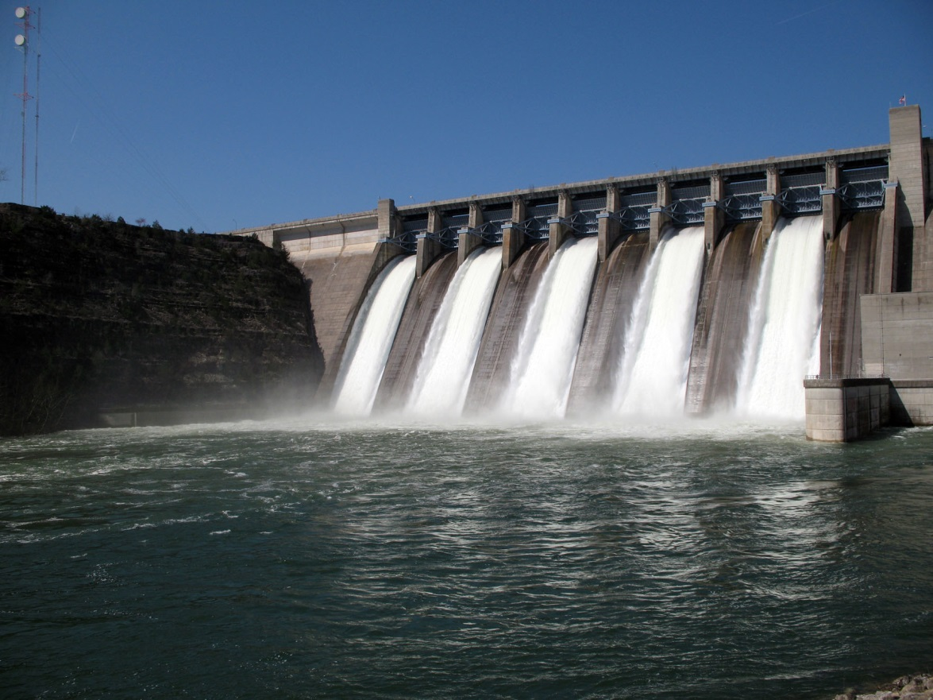
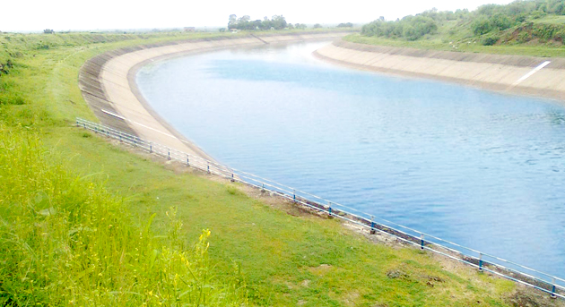
Dams
Large dams can ensure the storage of adequate water not just for irrigation, but also for generating electricity.
Canal systems leading from these dams can transfer large amounts of water great distances.
For example, the Indira Gandhi Canal has brought greenery to considerable areas of Rajasthan.

Slide 3
Criticisms about large dams address
1
Social problems because they displace large number of peasants and tribals without adequate compensation or rehabilitation
2
Economic problems because they swallow up huge amounts of
public money without the generation of proportionate benefits
3
Environmental problems because they contribute enormously
to deforestation and the loss of biological diversity.

Slide 4

The people who have been displaced by various development
projects are largely poor tribals who do not get any benefits from these projects and are alienated from their lands and forests without adequate compensation.
The oustees of the Tawa Dam built in the 1970s are still fighting for the benefits they were promised.

Slide 5
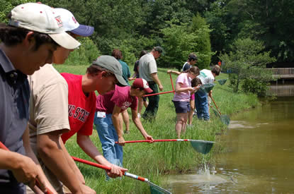
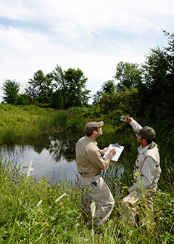
Water Harvesting
Watershed management emphasizes scientific soil and water
conservation in order to increase the biomass production.

Slide 6
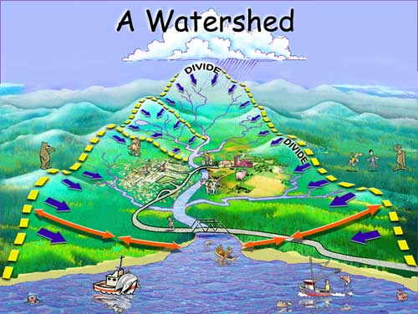

Slide 7
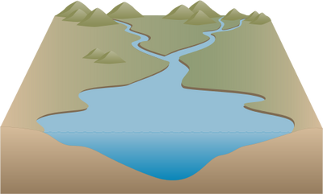
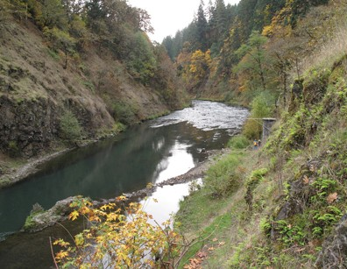
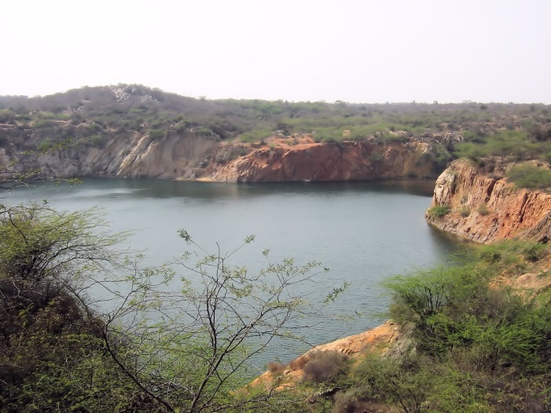
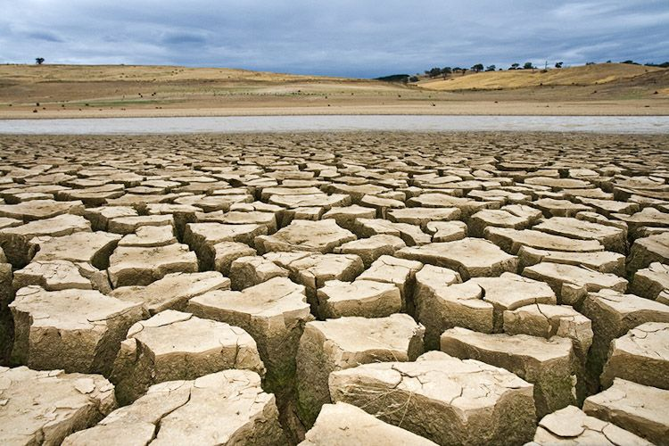
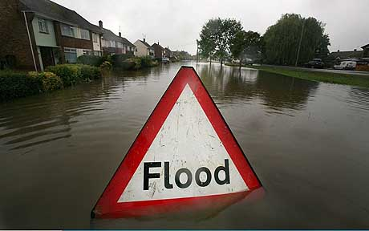
Watershed management not only increases the
production and income of the watershed community.
But also mitigates droughts and floods and increases the life of the downstream dam and reservoirs.

Slide 8
Thank You

